Slide 1

Report on Growth Analysis

Slide 2
Agenda
Introduction
Business Overview
Profit growth analysis
Customer Segment Analysis
Conclusion
Presentation Title

Slide 3

Introduction
This report analyze the growth chart pattern of “Edge Tech” over past 4 years. Mainly focusing on profit by firm and customer segment contributions. By analyzing them we can examine the profit trends and segment wise performance. The report aims to provide the insights of company’s strength and weakness

Slide 4


Profit Growth Analysis
ANNUAL REVENUE GROWTH

Slide 5
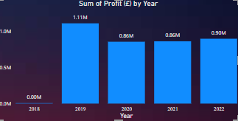
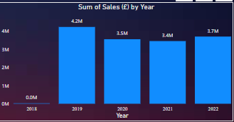
Yearly performance The profit growth charts of “Edge tech” shows a great performance in 2019 but afterwards it have to face a certain dip in its profit volume. The company's annual profits have decreased from $1.11 million in 2019 to $0.86 million in 2020. Main factor behind the negative profit growth is because of fall in sales in 2020. As in 2019 the firm’s total sales was 4.2M and in 2020 total sales was only 3.5M this negative dip in sales shows less profit after 2019.

Slide 6
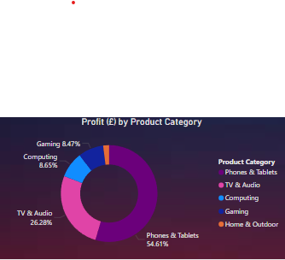
Profit From Different Product Category “Edge Tech” Company’s product segments have shown good contributions to overall profit. The Phones & Tablet segment continues to be the highest profit making segment, contributing 54.61% to the company's total profit. The TV & Audio segment follows closely, with a profit contribution of 26.28%. The Computing segment, Gaming and Home & outdoor segment while smaller, still added a significant 19.11% in profit, benefiting from the upsell opportunities tied to the primary product lines. Each segment has shown steady growth, reflecting the company’s strategic focus on diversifying its product offerings and meeting diverse customer needs.

Slide 7
“Customer Segment Analysis.”

Slide 8




Thank you

